Slide 1
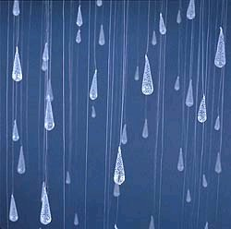
Rain Barrel Art
Inspired by
Hundertwasser

Slide 2
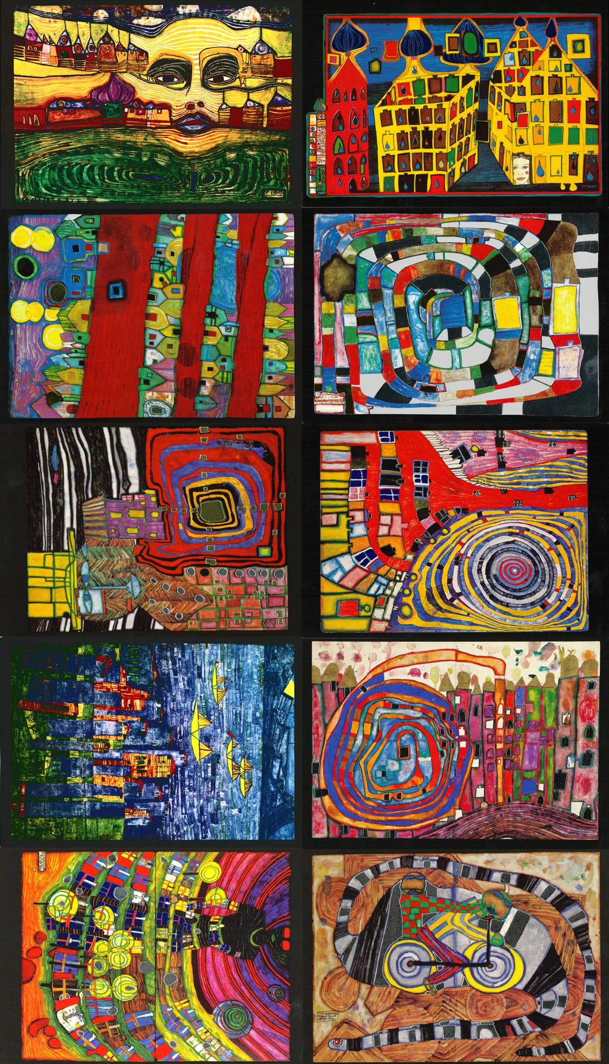
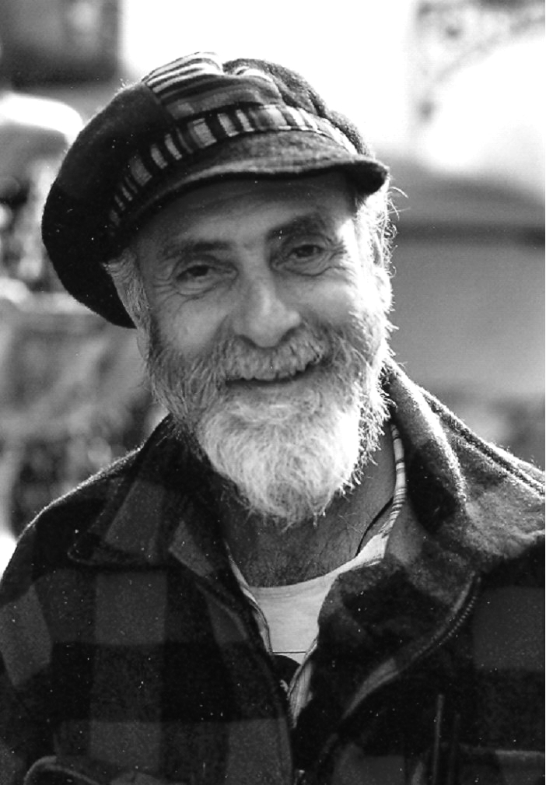
The Artist
Friedensreich Hundertwasser
Hundertwasser, a visionary and responsible creator, mobilizes the power of his art in order to spread his message for a life in harmony with nature and the individual creativity.
He is a symbolic figure for a non-conformist way of life, a forerunner of environmental protection and an ambassador for a self-determined alternative existence.

Slide 3
Did you know?
You can save 1,300 gallons of water in one summer by using a rain barrel!
A single inch of rain can produce more than 700 gallons of storm water that flows off a typical roof!
Water used to maintain gardens and lawns does not need to undergo the intensive process used for tap water! It’s a waste of energy!

Slide 4
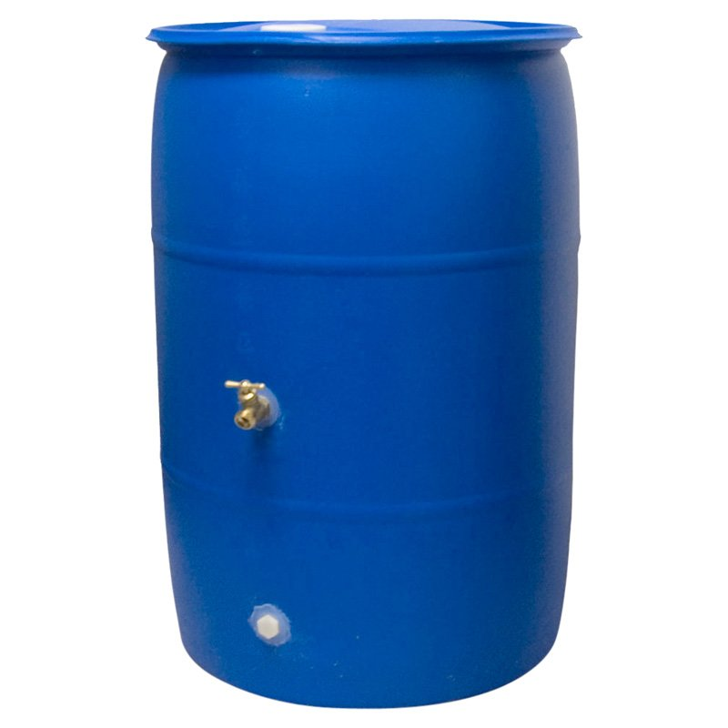
Rain Barrels Donated by:
Monroe Veterinary Associates
Enterprise Rent-a-Car
Mr. and Mrs. Webster
Mr. and Mrs. Hilling
Thank You!

Slide 5
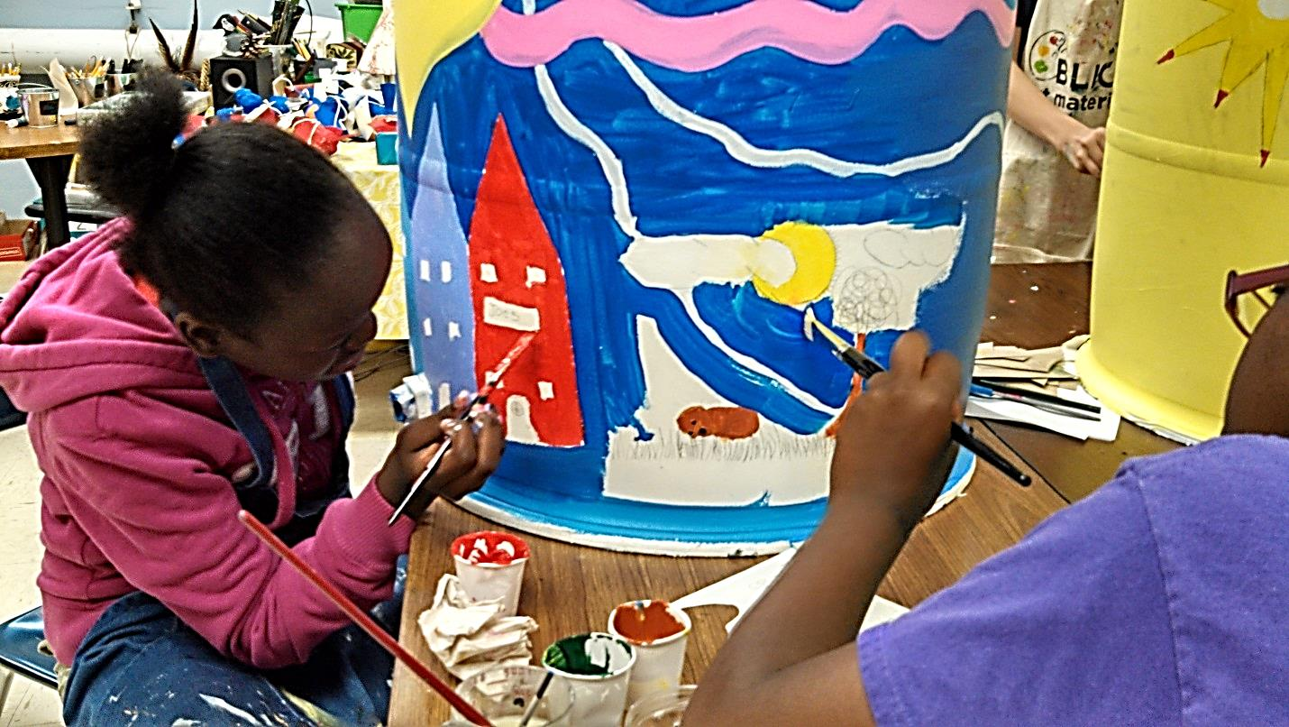

Slide 6
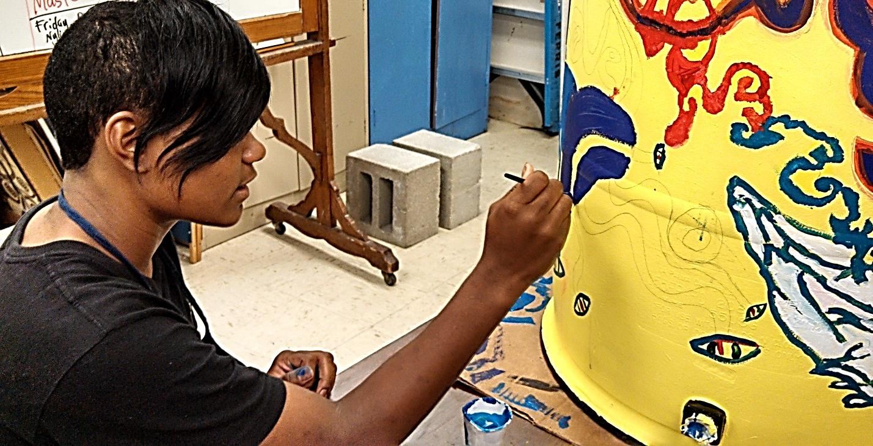

Slide 7
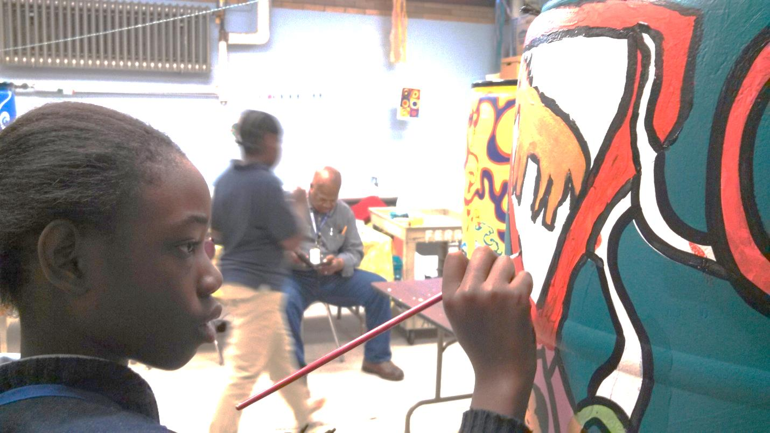

Slide 8
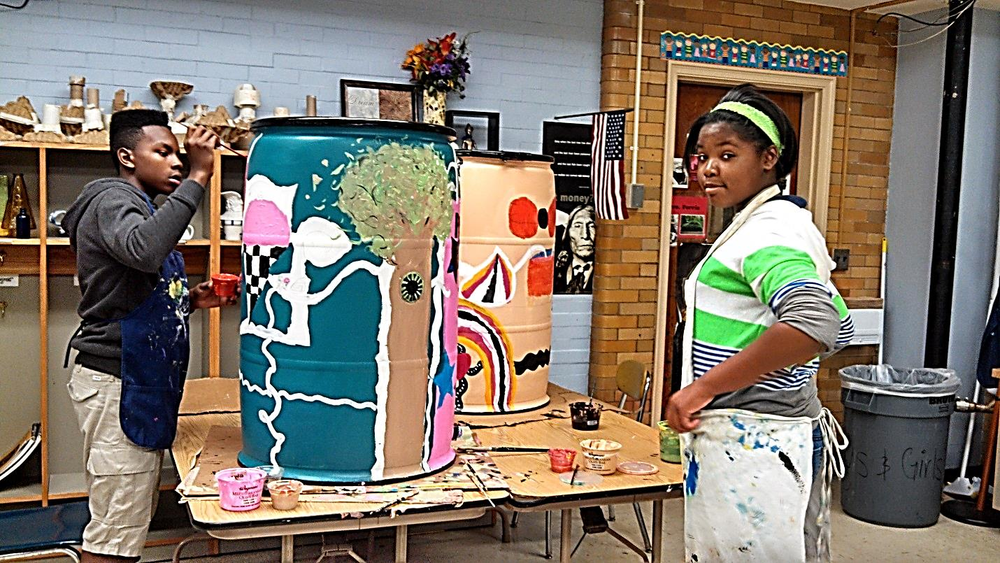

Slide 9
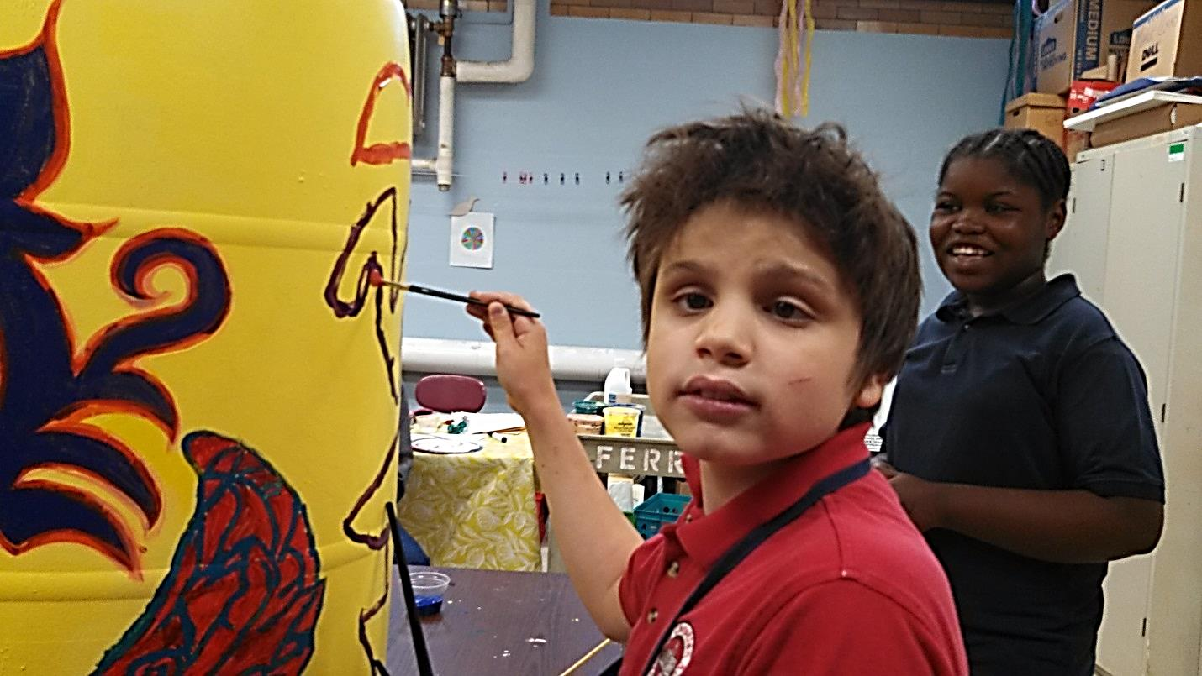

Slide 10
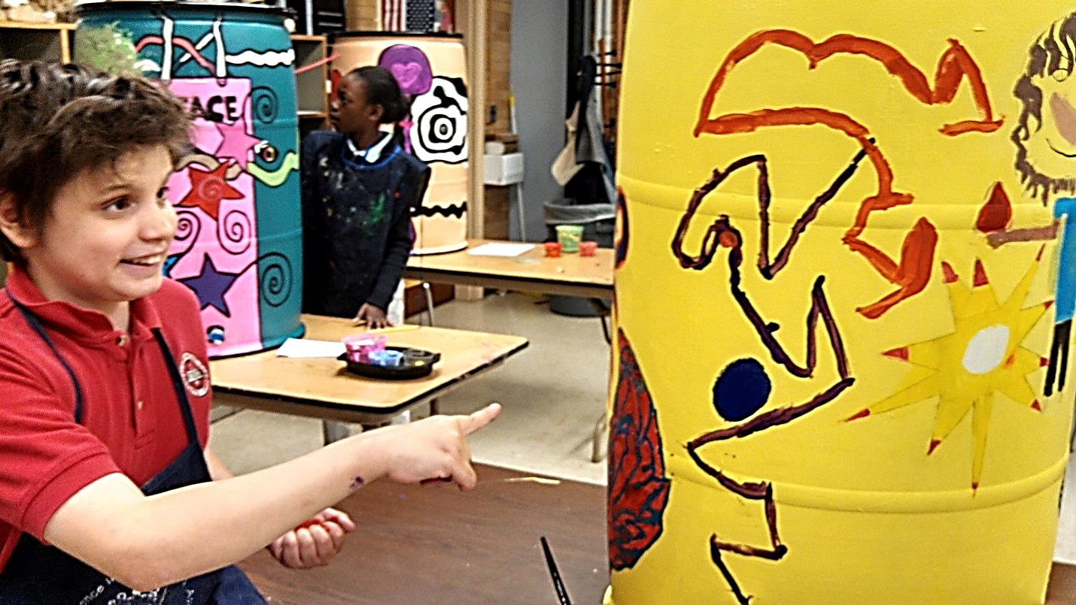

Slide 11
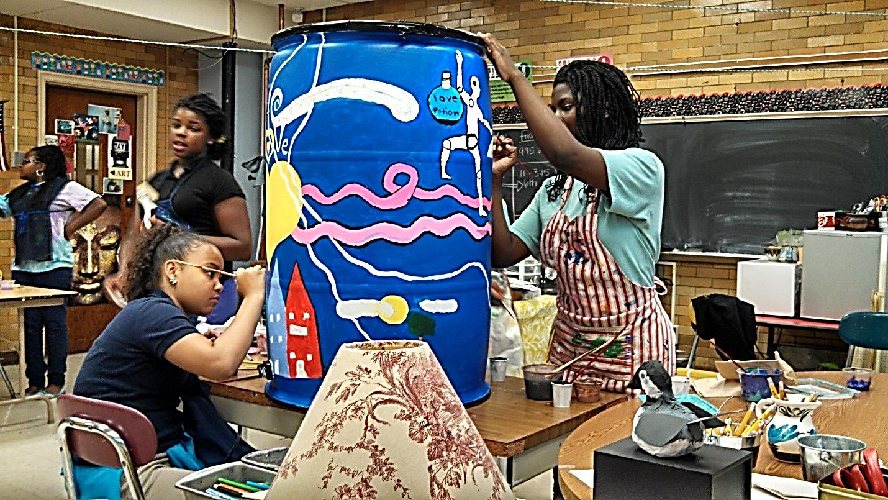

Slide 12
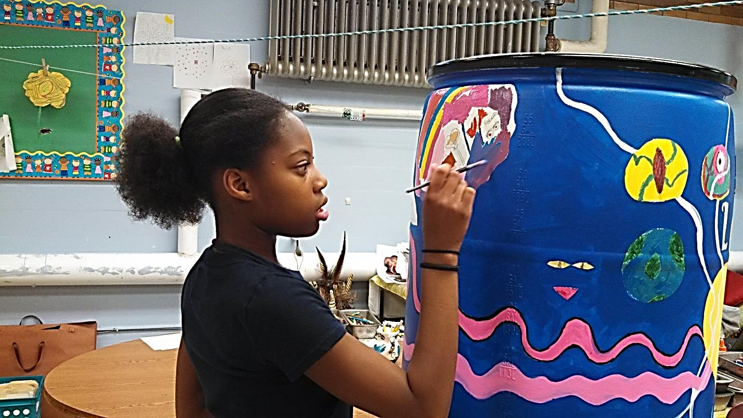

Slide 13
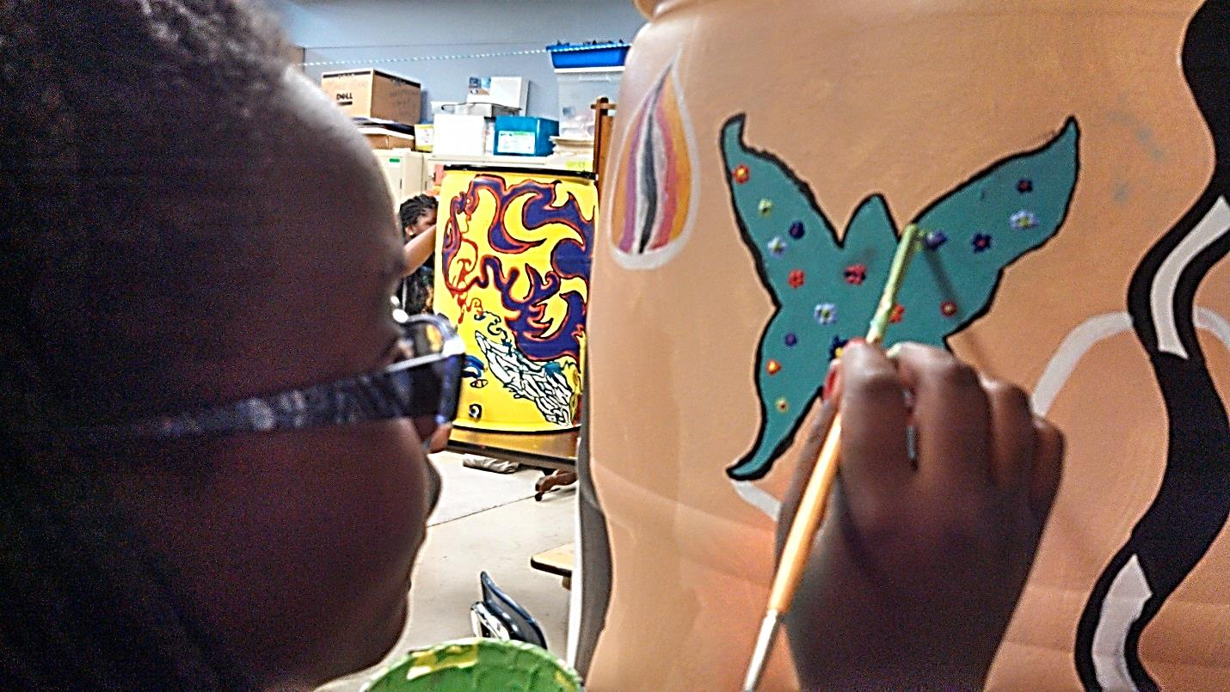

Slide 14
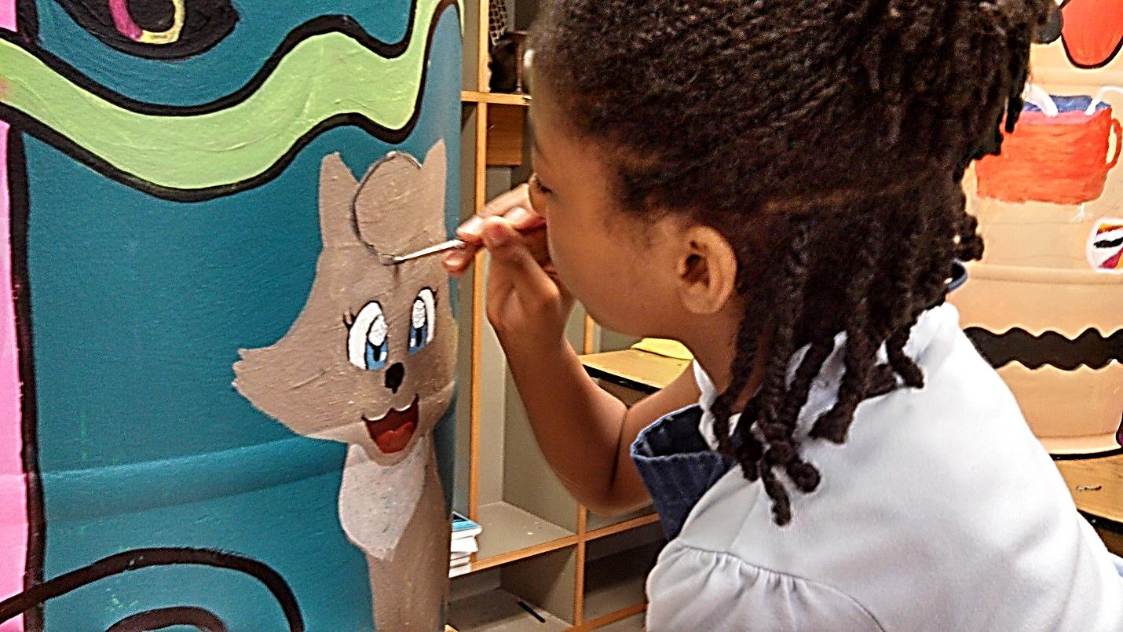

Slide 15
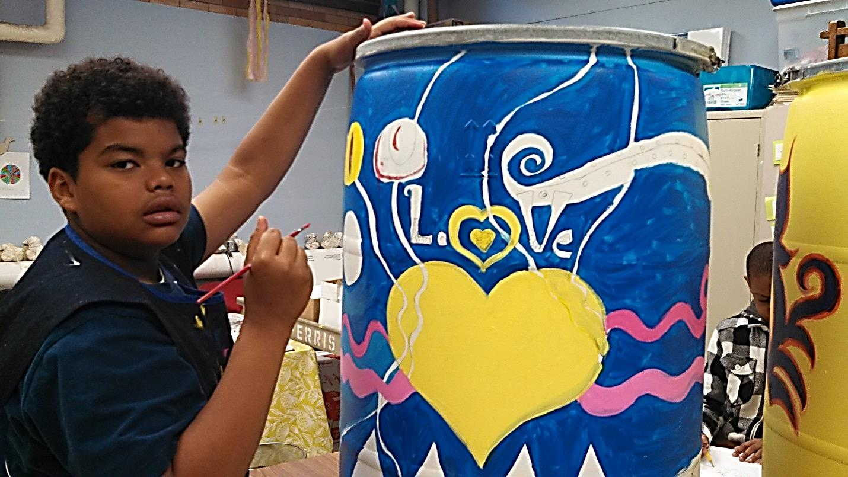

Slide 16
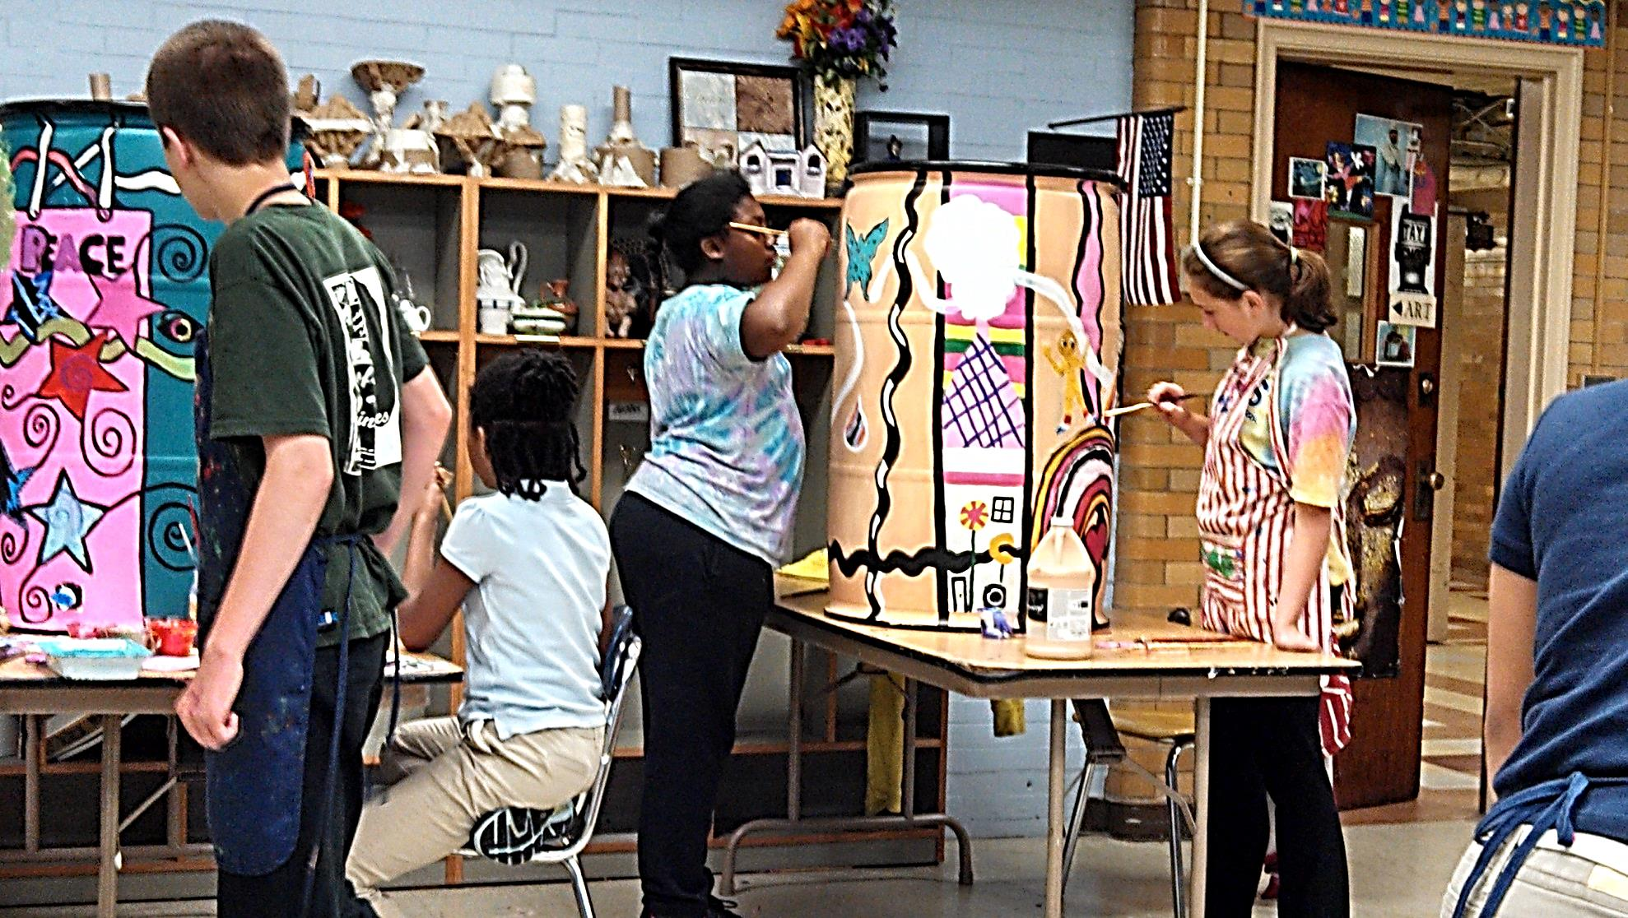

Slide 17
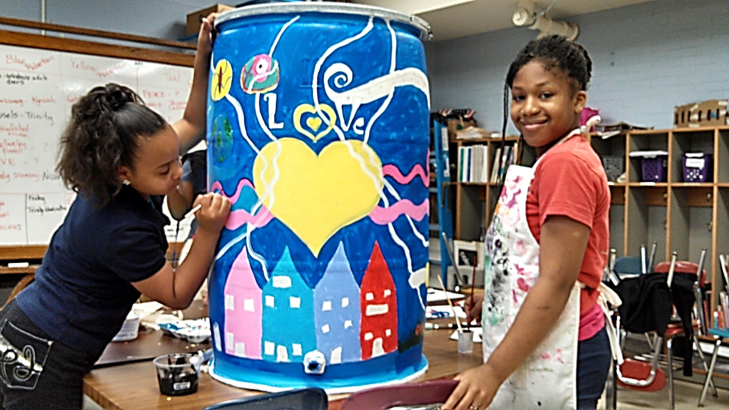

Slide 18
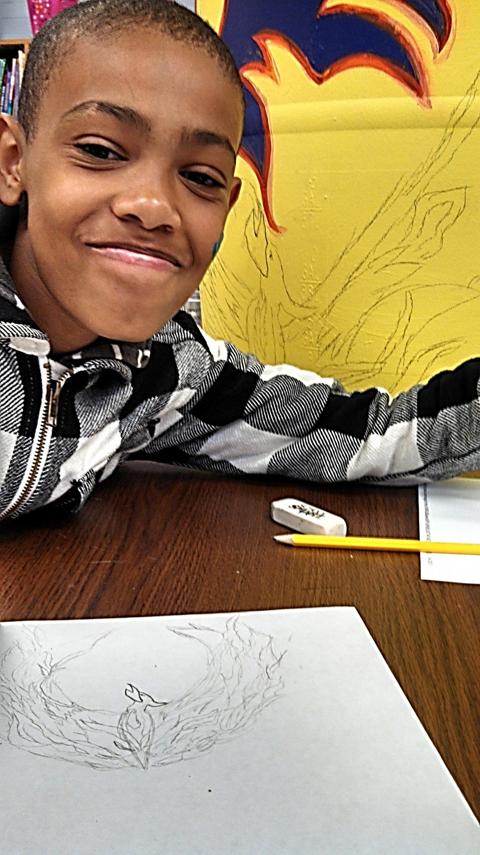
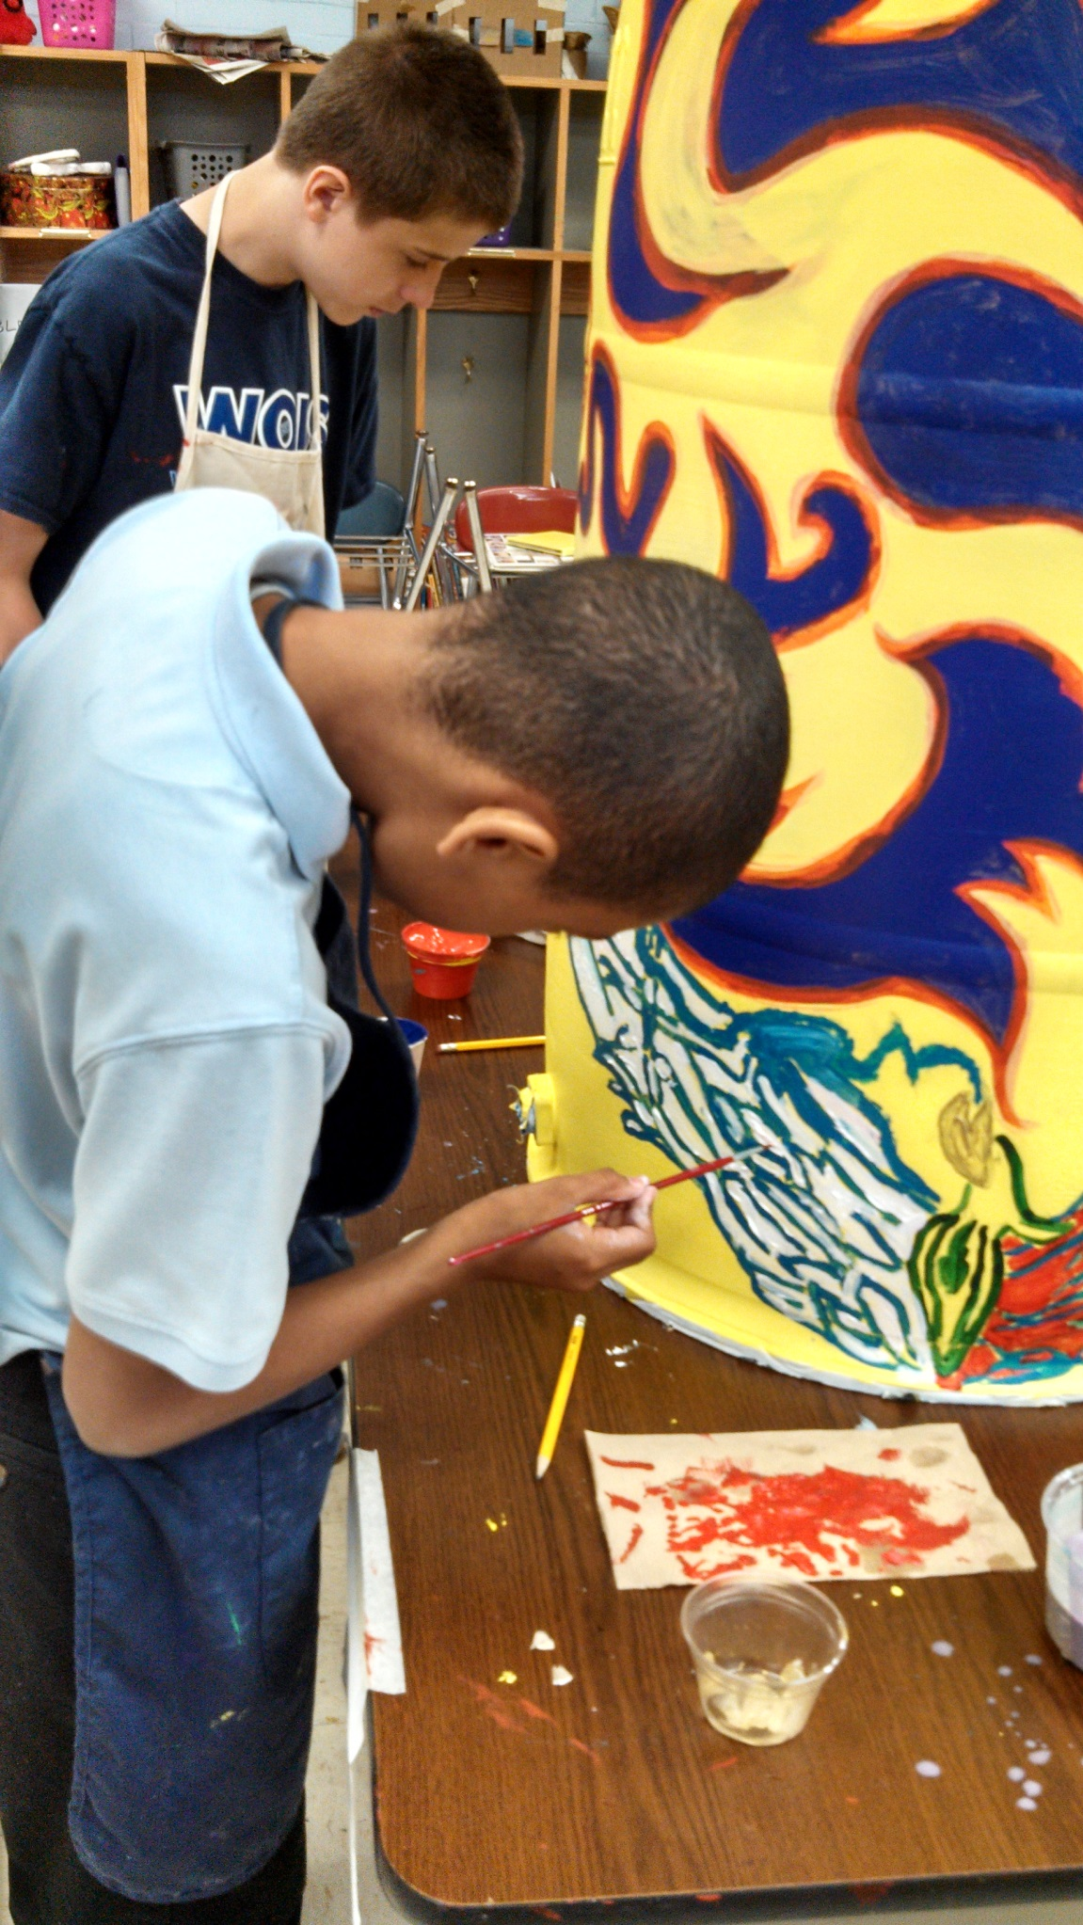

Slide 19
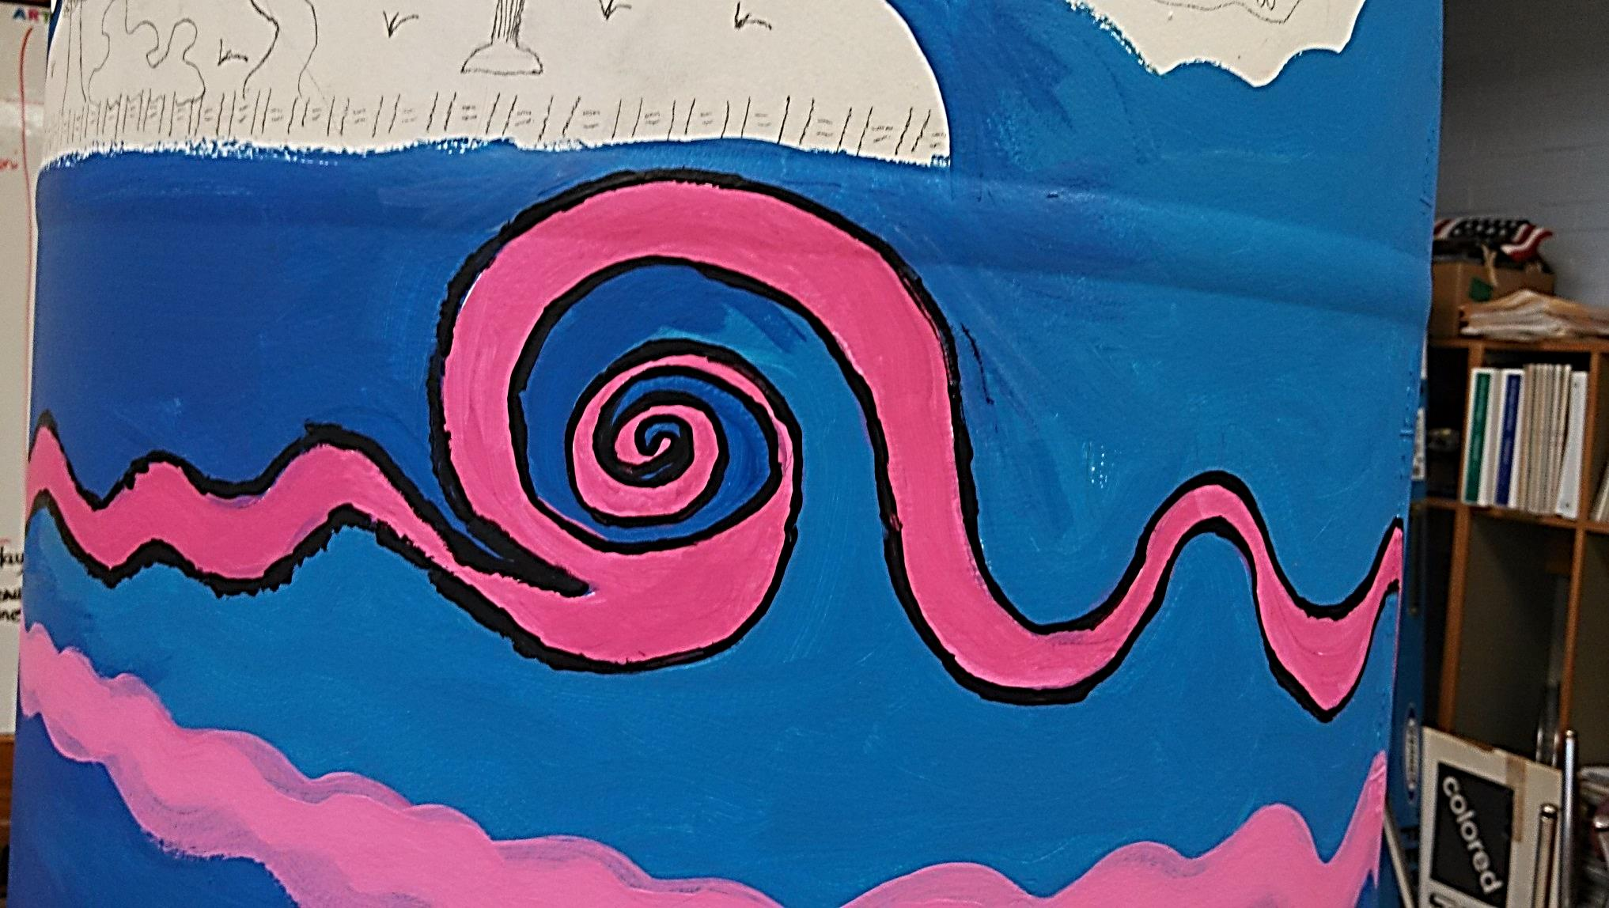
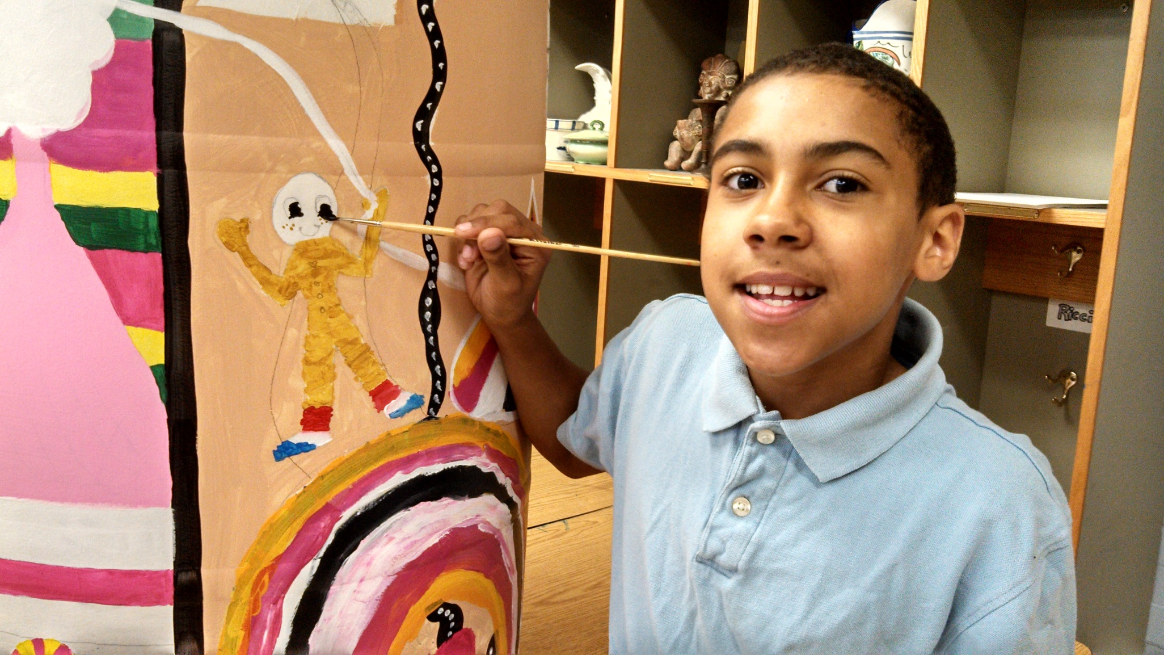
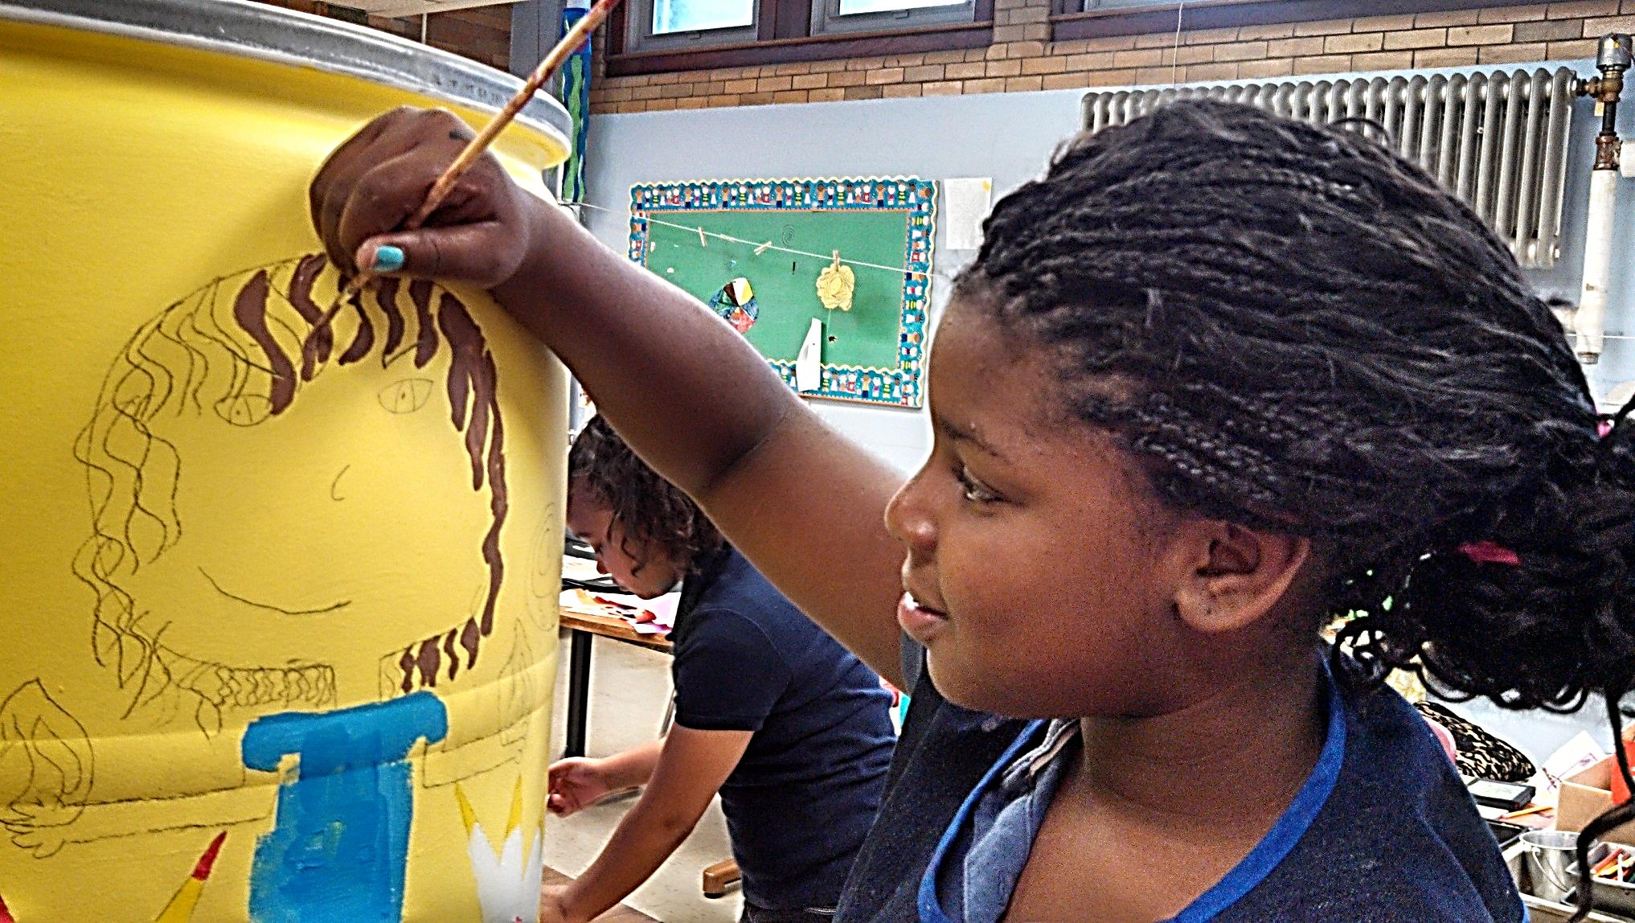

Slide 20
Service
Monies raised will benefit the Muller Field Station, a great, local resource for teaching students about the plants and animals of the natural world.
Bid High, Bid Often!
Help decrease the amount of tap water used for gardening and lawn care purposes

